Slide 1

You need to use visual props to develop social thinking concepts.
It’s not enough to use just words or worksheets.
It needs to be visual.
It needs to be fun.
To get their attention you may need to be a bit of a clown.

Slide 2

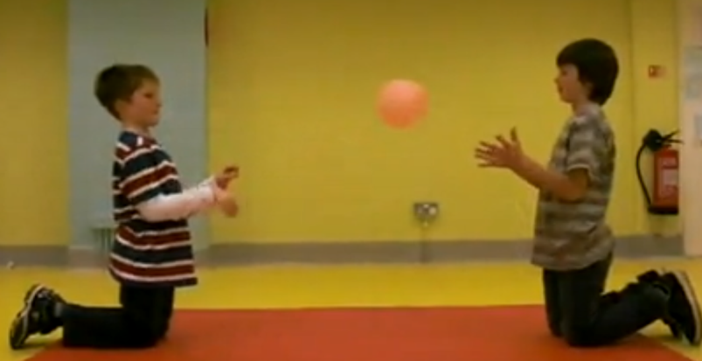
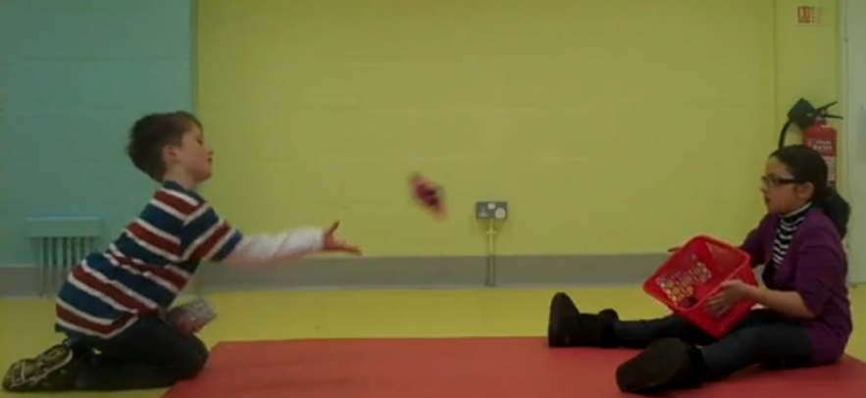
Joint attention/Intention of others
  toss a ball
- eye contact
- learn peers names

Slide 3
Some Social Thinking Vocabulary
Perspective Taking
Expected and Unexpected Behaviour
Thinking With Our Eyes
Body in the Group
Brain in the Group
Memory Files

Slide 4
Children with social thinking challenges
need to learn how to think socially
to be able to share space with others effectively.
The teaching has to be
more dynamic than static.

Slide 5
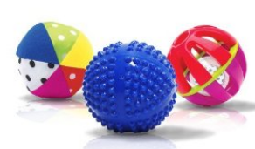
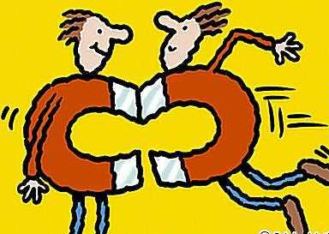



Initiating conversations - soft squishy ball
Keeping conversations going – soft/prickly ball
Back and forth conversations - open the door
- close the door
Turn-taking – use hand gesture
Perspective taking – directed drawing

Slide 6
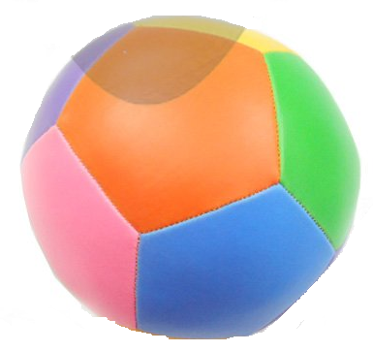
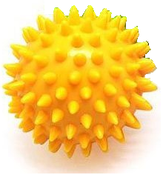

Thoughtful kind words
Prickly thoughtless words
Hurtful words

Slide 7


Thoughtful kind words
Prickly thoughtless words
Hurtful words
How do they make others feel?
How do they make others feel?
How do they make others feel?

Slide 8
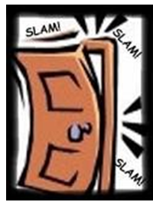
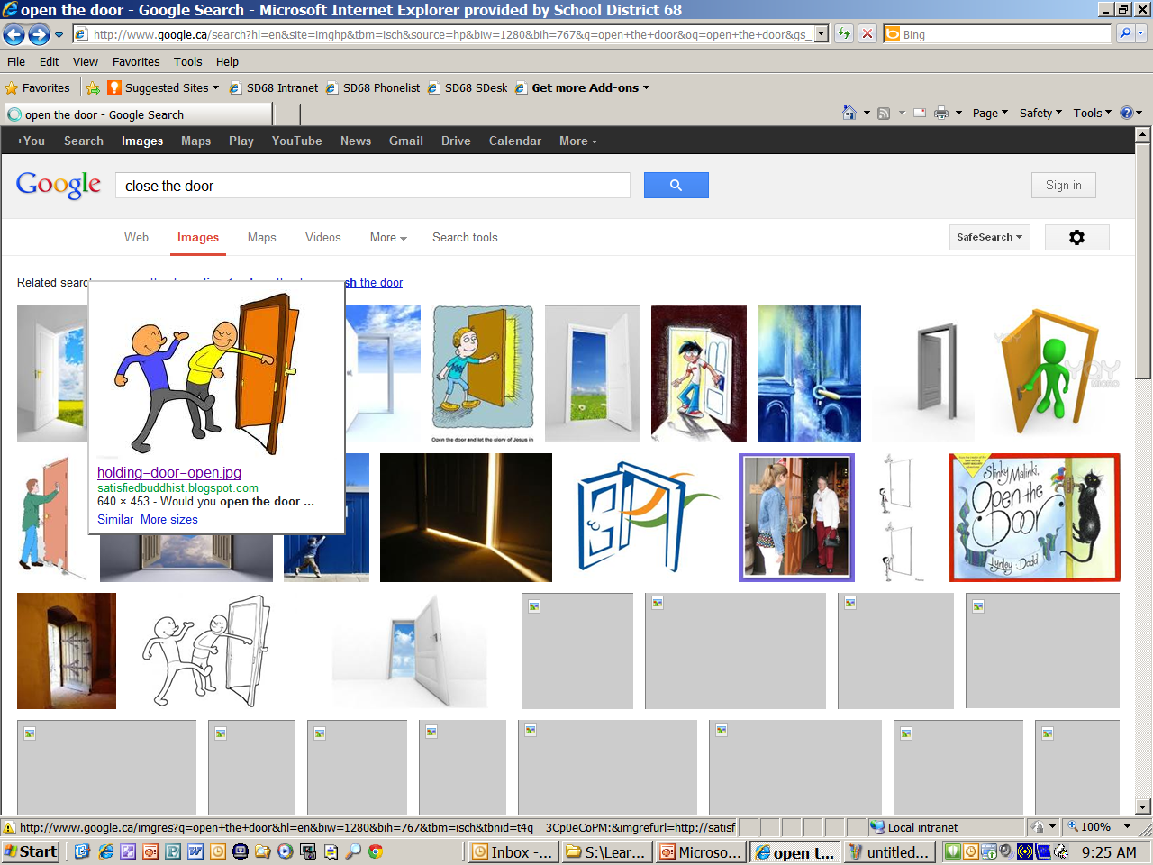
Open the door to a conversation
Close the door to a conversation

Slide 9
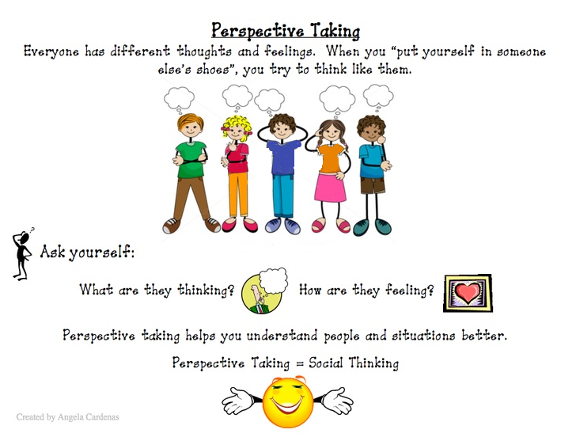
Notes:
9

Slide 10
Perspective Taking
Perspective
I can adjust my behaviour based on
other’s thoughts and feelings.
I know others have thoughts and
feelings different from mine.
I know I have thoughts and feelings.
Notes:
10
Students with Social Communication difficulties struggle to recognize that we don’t share the same brain. We don’t have the same knowledge, interests and feelings. Because they lack perspective taking, these students don’t realize that they effect how others feel and in turn effect how others will treat them.

Slide 11
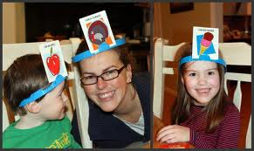
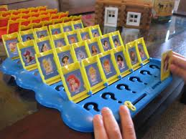
Activities to teach
Perspective Taking
Hedbanz
Guess Who
Notes:
11
It takes a lot of conversation about others to get students to start to recognize that others have different thoughts than them. Which often leads to the next difficulty…

Slide 12
http://youtu.be/8dgRTmx9wAg?t=6s

Slide 13
Expected and Unexpected
There are expected and unexpected behaviours within groups.
People notice how others are behaving and recognize if they are following the hidden or unwritten social rules.
People remember how you made them feel rather than what you said.
As with any Social Thinking concepts these rules are dynamic and constantly changing.
Notes:
13

Slide 14
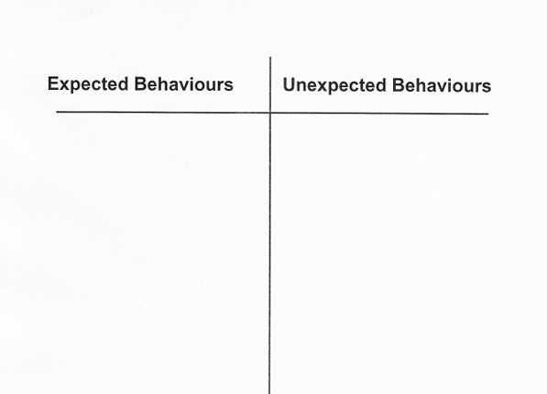
Activities to teach
Expected/Unexpected

Slide 15
Students need to know their behaviour affects others and that others will have thoughts about their behaviour…good thoughts or uncomfortable thoughts.
Students need more than the ‘what’ of positive behaviour.
They need the ‘why, when, where and with who.’
Behavioural expectations change with context.

Slide 16
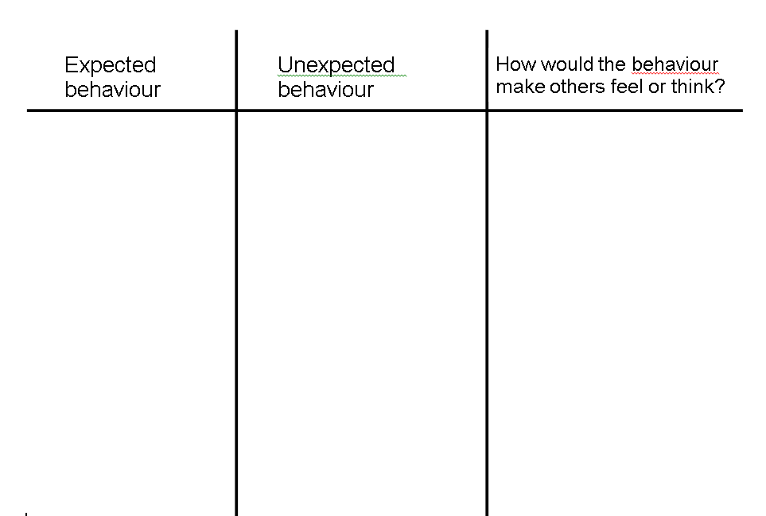

Slide 17
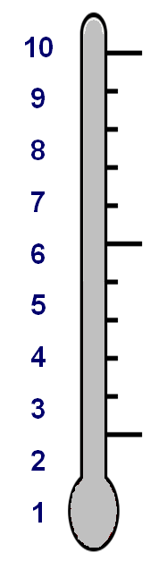
What happened The problem
How I handled the problem My reaction
Others think my reaction was: Expected/Unexpected
5
4
3
2
1
0
Your pet is hit by a car
Screaming/crying/sobbing
Very sad
Expected Reaction
Best friend moves away
It’s a small problem so people expect a small reaction.
Favourite activity cancelled
Upset
Darn it!
Forget lunch at home
Oh well, it’ll be okay
Misplace a shoe
Unexpected Reaction
Why do you think that?
___________________
___________________
___________________
___________________
No problem
No reaction

Slide 18
What happened The problem
How I handled the problem My reaction
Others think my reaction was: Expected/Unexpected
5
4
3
2
1
0
Your pet is hit by a car
Screaming/crying/sobbing
Very sad
Expected Reaction
Best friend moves away
Why do you think that?
___________________
___________________
___________________
___________________
Favourite activity cancelled
Upset
Darn it!
Forget lunch at home
Oh well, it’ll be okay
Misplace a shoe
Unexpected Reaction
Why do you think that?
It’s a small problem so when people see a big reaction they think it’s odd or weird
No problem
No reaction

Slide 19
Body in the Group
Our physical presence lets others know we are a part of the group.
Not only do we need to be close to those we wish to interact with, we need to have our bodies facing towards that person as well.
Successful social interactions depend on our bodies as much as our words.
Establishing our physical presence is a crucial precursor to an interaction.

Slide 20
Activities to teach
Body in the Group
Teacher does not listen with whole body and have students identify the behaviour and show how to correct.
Watch videos or look at pictures to identify who is and isn’t whole body listening.
Using Our Body and Mind Worksheet (p. 62 Think Social, Winner, 2008)
  Students take turns taking a piece of paper and act out the behaviour indicated on the paper.
  Other students have to guess the behaviour.

Slide 21
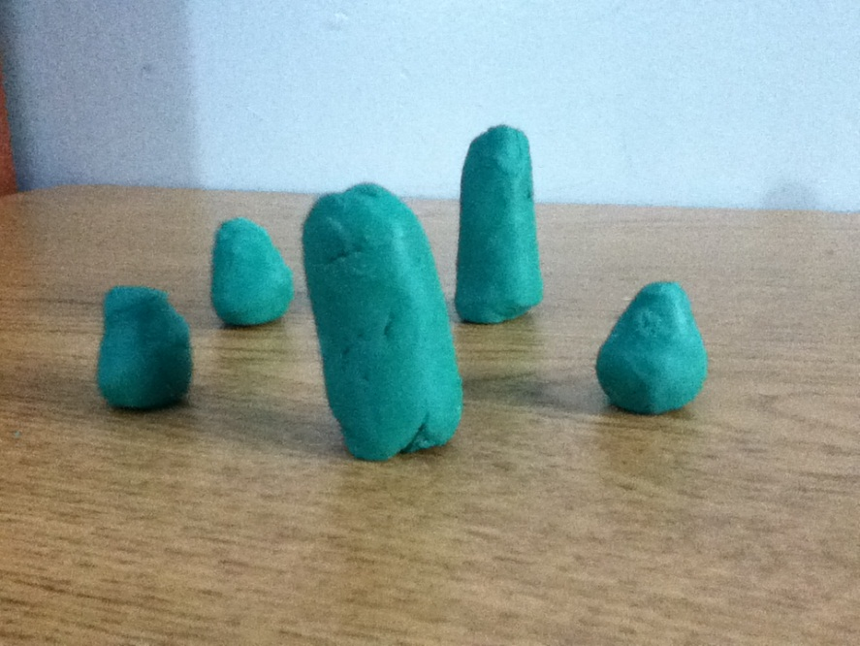
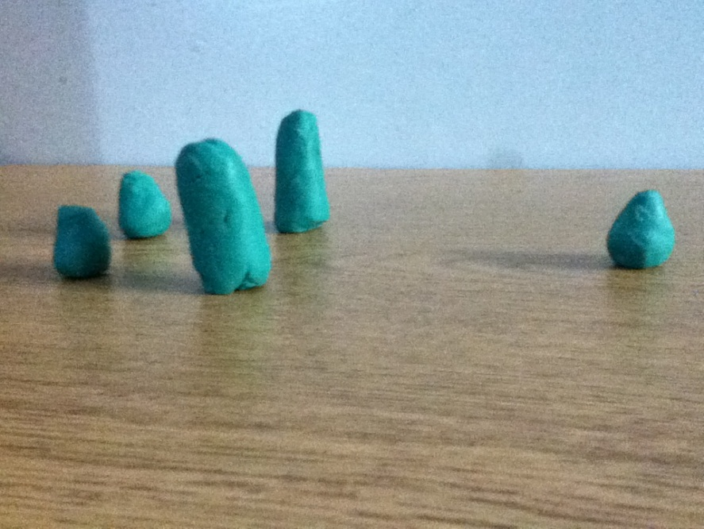
Activities to teach
Body in the Group
Playdough People

Slide 22
Thinking With Our Eyes
It is more than eye contact.
We get a lot of information about people when looking at them.
Joint Attention - the ability to follow someone’s eyes to see what they are looking at and determine what the person is thinking about. This typically develops at 9 – 12 months of age.
This helps to read others plans and anticipate what others are going to do.

Slide 23
Activities to teach
Thinking With Our Eyes
Eyes Are Like Arrows
1. Teach that the eyes are like arrows.
They point at what people are looking at.
2. Draw pictures of the eye and discuss how it
works.
3. Teacher looks at something in the room and
student guesses what they are looking at.

Slide 24
Activities to teach
Thinking With Our Eyes
4. “Who wants the ball game” – make eye contact to the person who you are going to throw to.
5. Watch a video and stop when someone is looking at something specific. Ask what they are looking at and predict what are they going to do?
6. Make a tower – One person moves a block, then with their eyes they “tell” who is next and which block they should use.

Slide 25
Instructional strategies to use when teaching social thinking at the secondary level
Notes:
25

Slide 26
Memory Files
We store information about other people in files in our brains.
The next time you see the person, you open that file about them and add to it.
Notes:
Students with Social Communication difficulties don’t keep files about other people.

Slide 27

Name
What we know about…
What we know about…
What we know about…
What more do we know…
What more do we know…
What more do we know…

Slide 28
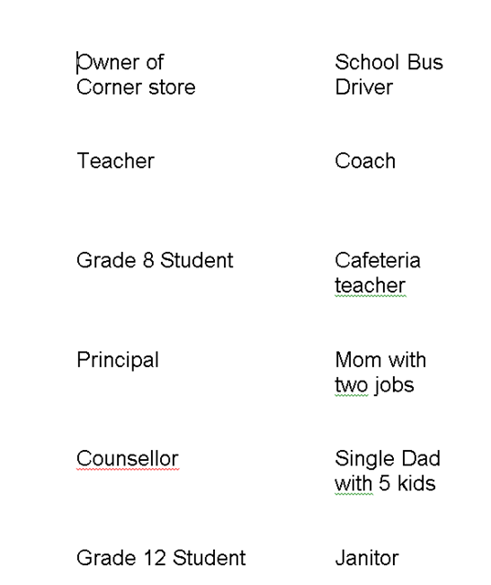
On the bus
Off the bus

Slide 29
Levels of friends: (Michelle Garcia Winner)
Greetings – short and friendly
Acquaintance – someone you meet in a certain situation
Evolving Friendship – arrange to be with them in a different situation
On Again/Off Again Friend – seasonal friends
Bonded Friendship – meet up at school and hang out on weekends
Close Friend – have deeper discussions

Slide 30
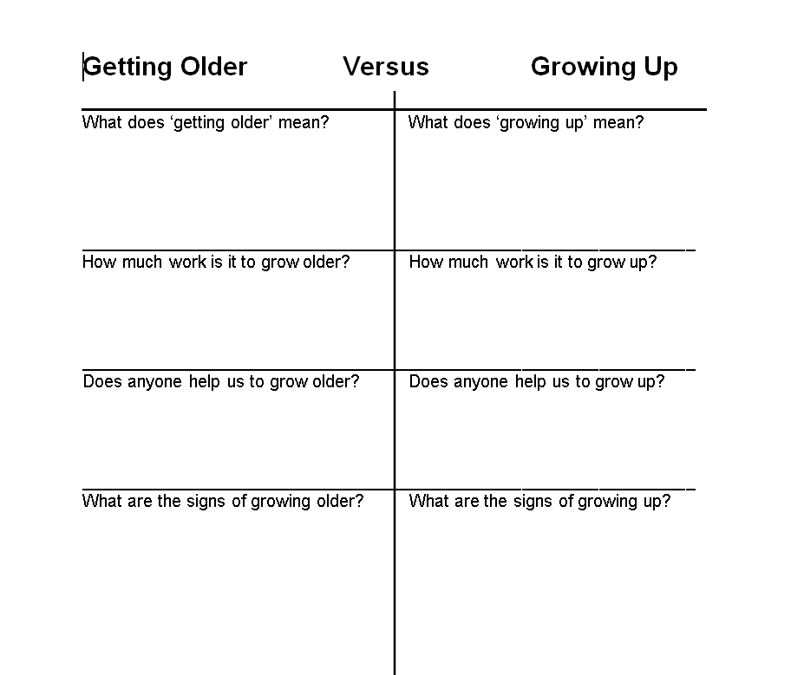

Slide 31
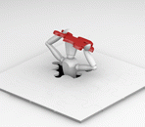
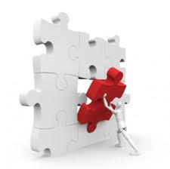
Self-understanding
Social Awareness

Slide 32
For some students, their ability to learn social thinking skills may be extremely slow, but any progress will improve their quality of life.
For others, they say…
“I still have autism, but I’m not as disabled by it.”
“I still have a visual impairment, but I’m more socially aware.
Notes:
32

Slide 33
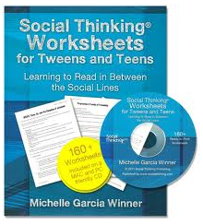







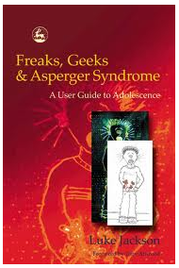
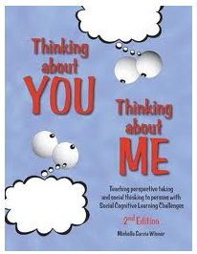

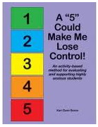


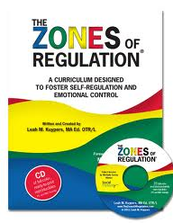
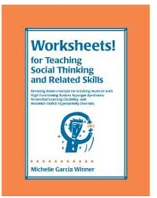

Notes:
33

