Slide 1

Behaviourists would say that we learn most behaviours through modeling.
However, early physical movement does not develop through modeling and is innate.
It is becoming increasingly understood that social thinking is also innate in neuro-typical children.

Slide 2
We just ‘know it’ without being taught.
We assume that our students are good social thinkers and are able to regulate their behaviour in diverse social settings.
Notes:
2

Slide 3
Unfortunately, those with social communication deficits are not hard wired to be able to think socially without being directly taught.
A student will often say, “How does he/she do it?”
Notes:
3

Slide 4
Teaching social skills
Teaching the skill of thinking socially
Discuss with a partner:
What does each statement mean?
Notes:
4

Slide 5
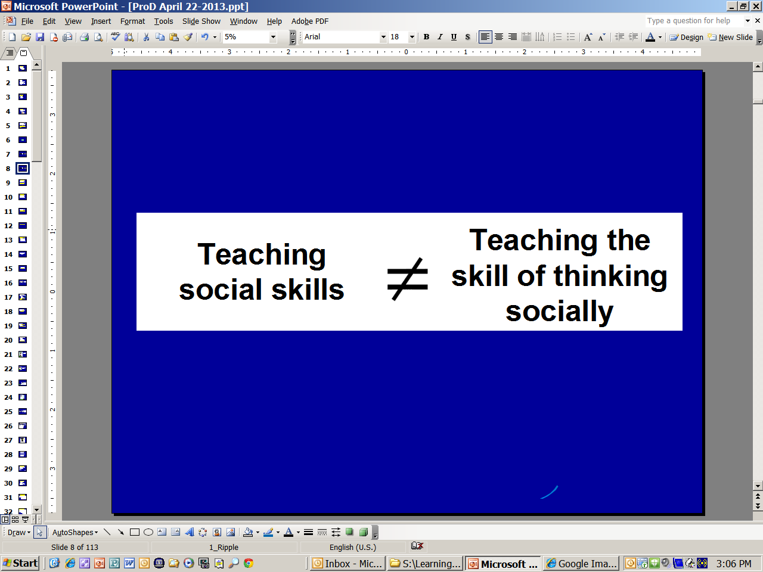
IEP – Goal Area – Social Skills
Objectives: (Examples)
John will use his quiet voice in the hallway.
John will say ‘hi’ to five classmates each day.
John will put his hand up and wait for the teacher.
Notes:
5

Slide 6
IEP – Goal Area – Social Thinking
Objectives: (Examples)
Jenny will use a more formal language when speaking to her teachers or principal.
Jenny will look in the direction and nod when someone is speaking to her even when the topic is not of interest (the social fake.)
3. Jenny will look to see what others are doing before/instead of asking the teaching what she needs to do.
Strategies: Role playing, discussion groups
Notes:
6

Slide 7
Social thinking or social cognition is very difficult to measure.
It is easy to measure a specific social skill in a highly structured testing situation, but social thinking is more dynamic than a list of single skills, therefore very difficult to cleanly measure.

Slide 8
In the past we have focused on teaching rote social skills such as greetings, eye contact, etc.
Social thinking is not just teaching
how to behave.
Social thinking teaches us to understand why we are expected to behave in certain ways.
Notes:
8

Slide 9
Children with social thinking challenges
need to learn how to think socially
to be able to share space with others effectively.
The teaching has to be
more dynamic than static.

Slide 10
Michelle Garcia Winner states:
“Rather than teach eye-contact;
teach we are thinking with our eyes.”
Notes:
10

Slide 11
What do we need to know to teach social thinking?
Understand the Hidden Curriculum.
A set of unwritten social rules and expectations of behaviour that we all seem to know but were never taught.
Notes:
11

Slide 12
Hidden Curriculum examples:
Knowing when to talk and when to listen
Knowing when to be honest and when not to be
Knowing how to position your body to participate effectively in conversations
Knowing what questions may be awkward or inappropriate to ask
Notes:
12

Slide 13
The Hidden Social Rules
Knowing these rules helps us know what to do or how to act in a situation.
Not knowing may make us feel confused as to why we don’t ‘fit in’.
Notes:
13

Slide 14
Someone doesn’t understand the hidden curriculum when you find yourself saying:
‘I shouldn’t have to tell you, but...’
‘It should be obvious that…’
‘Everyone knows that…’
‘No one ever…’
Notes:
14

Slide 15
Remember…
Hidden social rules change with age.
Notes:
15

Slide 16
  When you only teach the ‘what’ of a behaviour you are addressing:
    just one skill
    in one situation
    with one person
    at one time in the child’s life.
  Some children have a difficult time taking that skill and applying it to other situations.
  So what seems like a similar behaviour to us is a brand new situation to them.

Slide 17
Not all social communication involves language.
Consider social thinking in the following environments:
- A public washroom
- A supermarket line-up
- Driving
- Entering a room full of people
Notes:
17

Slide 18
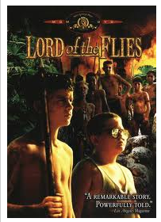

Effective social thinking is important throughout life.
It is needed to be successful in academics:
- understanding the motives and intentions of others (Language Arts and Social Studies)
- every moment of academic teaching is done within a social context
Notes:
18

Slide 19
Effective social thinking is important throughout life.
It is needed at home:
- understanding a TV show or movie requires understanding of the character’s emotions, thoughts, reactions, and intentions
- reading fiction requires the same social thinking
Notes:
19

Slide 20
Effective social thinking is important throughout life.
It is needed in adulthood:
- holding a job requires adjusting our behaviours based on the thoughts and intentions of those we work with
Notes:
20

Slide 21
When a student doesn’t think in a social manner, peers begin to feel that it is ‘just too much work to be their friend!’ and they choose to hangout with someone else.
With each negative social experience a student can become more lonely and depressed.
Many students just give up trying to be social.
Notes:
21

Slide 22
Poor social thinkers can experience:
Overload
Isolation
Depression
Anxiety
Suicidal thoughts
Notes:
22

Slide 23
These individuals are six times more likely to suffer from mental illness compared to the typical population.
Notes:
23

Slide 24
Their disability will never be cured.
They need to be provided with different strategies over time that will help them cope in a social world.
Notes:
24

Slide 25
Creating a Social Thinking Group

Slide 26
Social thinking classes provide a structured, safe environment where students can learn how to think in a more social manner.
Deeper change over time.
Notes:
26

Slide 27
Students benefit from:
a structured approach to teaching social thinking
an autism-friendly environment where they are offered clarity about confusing social situations
lessons that are more dynamic and static
role-playing activities that use flexible thinking
lots of time to practice the skills in different contexts
A ‘Social Thinking’ class helps them navigate in a social world they often find confusing.

Slide 28
This does not mean that you
use a workbook or a series of videos
and go through them lesson by lesson.
All learning is embedded in the
social thinking class.

Slide 29
Things we need to consider:
Age
Level of cognition
Ability to self-regulate
Ability to communicate
Level of social awareness
Level of commitment of student
Current level of independent social interaction
Environment
Other neurological issues (Visual Impairment)
Notes:
Today I’m going to describe the core challenges of autism and how they can impact the learning and behaviour of a student with a visual impairment. I’ll discuss difficulties with self-regulation; higher level thinking; and reciprocal social interaction. After the break, I’ll share teaching strategies that I’ve used to help address the educational needs of these children. And then after lunch, I’m going to put you through a set of simulation activities to help you better understand the core characteristics of autism.
29

Slide 30
Students need to be directly taught and provided opportunities to practice social thinking such as:
- Thinking with their eyes
- Reading body language
- Using appropriate personal space
- Understanding the motives of others
- Understanding metaphors etc.

Slide 31
How can you teach social skills?
Identify Skills to be Taught
The ability to:
initiate and maintain play with a peer
interpret facial expressions
initiate and maintain conversations
ask for help appropriately
work in groups cooperatively
make social predictions
predicting intention of others
Notes:
-Point here is that socialization and communication development involves sharing attention with others, and this is very difficult for students with ASD
-we understand motion to “come”, arms out for a hug, and enjoying the same activity together

Slide 32
The structure is in the way you set up the routine of the class.
Round Table Discussion
Targeted lesson
Time to hangout
Notes:
32

Slide 33
The structure of the class – Round Table
Provides opportunities:
    For each student to have the spotlight, share information and know the group is listening
    For all students to listen to each speaker and learn more about their peers
    For the students to find common interests
    For the students to share positive and difficult moments in their lives without being judged
Notes:
33

Slide 34
The structure of the class – Round Table
2. Teaches:
    Keeping your body in the group
    Showing active listening
    Giving eye contact
    Waiting your turn
    Holding a thought until it’s their turn
    Using the ‘Social Fake’
    Creating ‘Memory Files’ about their peers
    Keeping comments positive
    Etc.
Notes:
34

Slide 35
The structure of the class – Targeted lesson
Provides opportunities to teach:
Self-awareness - Understanding their challenges
Interpersonal Skills – Conversation skills and
group dynamics
Expected behaviours in different contexts
That others have thoughts and feelings that are
different from their own and need to be respected
Notes:
35

Slide 36
The structure of the class – Targeted lesson
  Use non-verbal communication
  Understand different perspectives
  Be mindful of their responses
  Handle situations outside their comfort zone
  Deal with conflict
  Cope with anxiety
  Practice initiating and continuing a conversation
It is sometimes easier to talk in 3rd person when making comments.
Notes:
36

Slide 37
The structure of the class - Hangout
Scheduling time to hangout at the end of the lesson provides time to:
  Practice the targeted skills
  A chance to get out of their ‘comfort zone’
  Learn to ‘have a friend.’
  Begin to transfer the skills to ‘real life.’
  HAVE FUN
Notes:
37

Slide 38
Instructional strategies to use when teaching social thinking at the elementary level
Notes:
38

Slide 39
At the early primary level, it is better to work on joint attention and showing interest in others with one or two other students than to try and teach a social skills lesson to the entire class.
Notes:
39

Slide 40

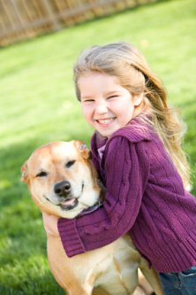
Learning kids names – picture book
Showing interest in others – model interest
This is Sarah.
Sarah has a dog.

